Slide 1

“Strategies to Add Value to the Product and Provide the most in demand Features to the Customers.”
(For a mobile manufacture-based firm)
By Shubhang Singh

Slide 2
AGENDA
Objective
Background
Key Findings
Recommendations
Appendix:
Data sources
Data methodology

Slide 3
OBJECTIVE
Provide major insights into the cell phone industry to hep them develop a new product optimally.
To tweak the marketing strategies in order to add more value to the product and close the supply-demand gap.

Slide 4
BACKGROUND
As the firm has just entered the mobile market three years ago, they want to understand their competitors and preference of their users; so that they can design their strategies accordingly.

Slide 5
Popular Brands!!
The most reviewed brands include Samsung, Motorola, LG, Huawei, HTC, Blu and Apple.
Since now we know how the market is controlled by these competitors, we can focus on the features and services provided by these brands.

Slide 6
Customer Ratings w.r.t to Brands
Cross Referencing the Customers’ Ratings with respect to different brands, we observe that even though Samsung controls the major sector of the market in terms of popularity, still other brands like LG, Apple, Blackberry, HTC, Huawei are positively related.
This means we must look at features provided by each brand.

Slide 7
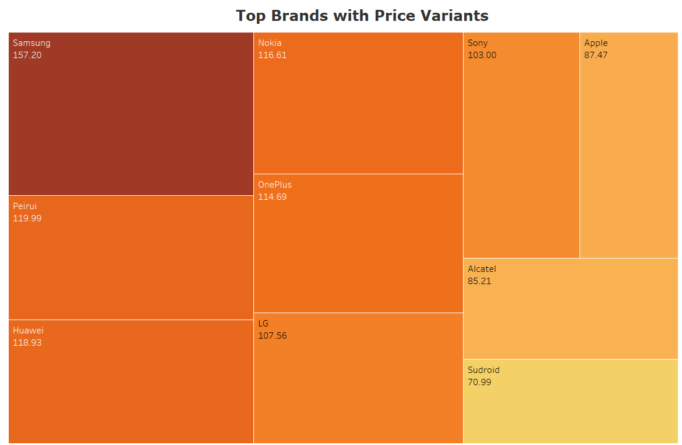
Top Brands with Price Variants
The price preferred by the customers lies in the range of 150$ - 70$.
This should be the price segment that we should be targeting.

Slide 8
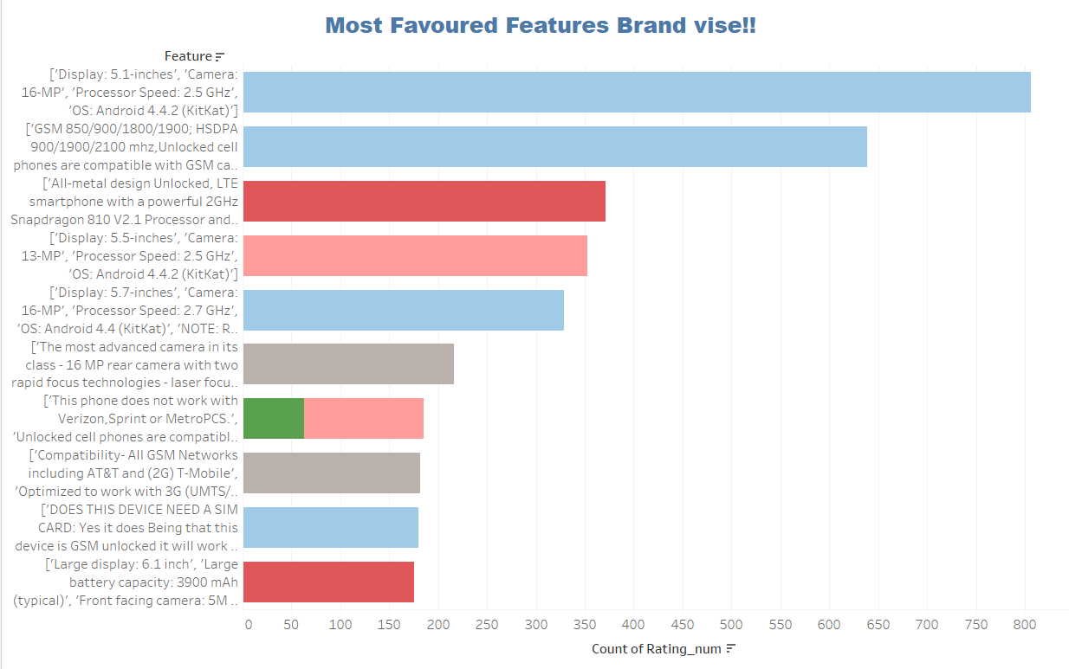
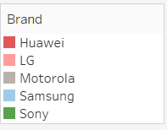
Top Voted Features!!
One of the most desired feature includes a Display size of 5.1 inches, Camera with a 16MP lens and a processor having 2.5GHz cloaking speed.
Also, the OS favored most is Android, this gives us an insight that the market we are focusing upon is majorly oriented to open-source platforms.

Slide 9
Top Features along with the Price offered!!
Although there are many features which are reviews positively, but we see that not all the features are not cheap and far more than the price range which we are targeting(150$-70$).
The only feature which is favored as well as cost effective includes a display of 5.7 inches, a camera of 16 MP, 2.7 GHz processor along with Android OS.

Slide 10
RECOMMENDATIONS
Since now we know our competitors include brands like Samsung, Motorola, HTC, Huawei and Apple; we have to keep a keen eye on the services and features offered by them.
The market we are focusing on is a mid range price segment market since the price range preferred is in the range- 150$-70$. This gives us the segment we need to focus and introduce our range of products in.
Features we must have- 1. Android OS, 2. 5.1-5.7 inches screen, a processor of 2.7 GHz and a camera of lens 16MP.

Slide 11
APPENDIX
Data Source: http://jmcauley.ucsd.edu/data/amazon/index_2014.html
Data Methodology:
Cleaning the data by summarizing rows and reducing columns.
Doing an exploratory analysis and formulating visualizations using Tableau
Using visualizations like Pie chart, Scatter Plot, Stacked bar chart, Heat map and Double Axis Chart.

